Slide 1


Titolo presentazione sottotitolo
Distribute System Project
Milano, XX mese 20XX
Distributed Job Scheduling
Carloni Filippo, mat. 921124
Carminati Fabio, mat. 919803

Slide 2
Overview
We have used Omnet++ to implement and model the system
In particular, are present mainly four different entities in the system implemented with different classes :
Job
Executor
Storage
Client
The channels between the various entities are bi-directional and it’s assumed they are reliable. In particular, it’s assumed TCP like connections when there is a channel
So, unicast communication is possible between entities.
All the various parameter of the simulation (job complexity, timeouts, delay in the channels, ...) can be modified by the omnetpp.ini file.
An exponential distribution is considered for the sending rate, timeout failure and job complexity in order to avoid deterministic values such that a more realistic behaviour of the system can be obtained.
Thus for these 3 parameters only the mean is specified.

Slide 3
Job
The Jobs are represented in the system by the JobMessage.
JobMessages are exchanged amid the various entities in the system and contains all the essential information to represent a Job:
RelativeJobId
ClientId
OriginalExecId
ActualExecId
JobComplexity
ReRouted
NewJob
IsEnded
StartingTime
EndingTime
Other fields are present in the JobMessage and they are used in the system for communication purposes (not all are related to a job, but for simplicity and efficiency we use a single type of message)

Slide 4
Executor
The Executors execute the received jobs from the Clients in a distributed way
The Executors communicate with:
Clients (status and job requests)
Storages (send and receive internal status)
Others Executors (load balancing operations and status)
The Executor is the only entity that can fail in the system:
Only crash are allowed (losing the partial computation of a job and losing internal state)
No Byzantine failure
No timing failure

Slide 5
Executor
Can be in two main different modes:
Normal Mode
Failure Mode
Ignoring all the incoming packets until timeoutFailureDuration expires
Reboot Mode
Ignoring all the incoming packets except those from storage
The Executors can crash (with different probabilities):
At the reception of each message
In the middle of computation (introduced in the most relevant cases), always after operations that modify the internal status of the Executor and the correspondent notification to the Storage.

Slide 6
Crash
The crashes are simulated in each Executor individually, the others Executors simply ignore not responding Executor
It is assumed that an Executor stays in Failure Mode for a limited period of time
If a crash happen (both in the middle or at the reception) these steps are followed by the crashed executor:
Enter in the Failure Mode
Empty all the data structures representing its internal status
Wait for the timeout, timeoutFailureEnd
Start of Reboot process, sending a JobMessage with the ReBoot field set to true to its storage
Retrieve all the data structures from its Storage, the process is ended by the flag BackupComplete set to true by the Storage in the last JobMessage
Enter in Normal Mode
Send Status updates to the Clients or Executors for its internal Jobs, and Status Request for the ReRouted Jobs

Slide 7
Load Balancing
The Executor performs Load Balancing with a certain granularity (granularity parameter)
Each time a new Job arrives from a Client the Executor evaluates if is necessary to do Load Balancing.
The new Jobs are evaluated with FIFO policy
To perform Load Balancing the Probing flag must be set to true
When a probing request arrives, the others Executor evaluate if theirs queues length are less than the one inside the probing request(QueueLength field) with a certain granularity (probeResponse parameter)
If the condition is verified the Ack field is set to true and the QueueLength parameter is set equal to its own length
The original Executor waits for responses timeoutLoad and after that:
if a response with a queue less than the the original Executor is found the Job is re-routed (at most once)
Otherwise the Executor executes the Job

Slide 8
Storage
Each Executor has its own Storage connected
Each storage save permanently and in a reliable way the internal status of the executor attached to it
The Storage CANNOT crash
The Storages save the jobs in four different std::map with a simple protocol:
insert operation: If a job arrives for a specific map and it doesn’t exist on it, the storage saves the job in the specified map
delete operation: If a job already exists in a specific map, the storage delete the job from that map
If ReBoot flag in the jobMessage is set to true, the Storage replies to the executor sending all the four maps contents and after that a final message with the BackupCompleted flag to true is sent.

Slide 9
Client
Clients communicate only with the Executors:
Send new jobs periodically (Executor is random selected) and then they are added to notComputed cArray
Request info about the status of the Jobs (completed or not completed)
Each Client is completely unaware if load balancing is performed or not for each Job (e.g. who is the the effective Executor, ActualExecId)
If an Executor doesn’t respond to a new Job request with a JobId for a given period the job is resent for a given amount of times, after that another Executor is selected for that Job
Periodically the Clients ask the status of the Jobs to the respective Executors (OriginalExecId), also they move all the Jobs to noStatusInfo cArray (assuming that there was a crash processing that job)
When there is a status response, if the Job is completed it is removed and notified, otherwise it is added to notComputed such that it will be re-asked later.

Slide 10
Status Request
The Client can request the job status only to the Executors they have sent it
A Status Request must have the flag StatusRequest set to true in the JobMessage during all the response process
If the Status Request is a response must have the Ack flag set to true, this can happen if:
It is a response directed to the Client
It is a response to a completed Job, it has the IsEnded set to true (it is used to remove the Job from the internal state of OriginalExecId and ActualExecId )
They are handled by the Executor asynchronously.
If the requested Job is processed by another Executor due of load balancing the request is forwarded to the ActualExecI by the OriginalExecId. Otherwise, the request is immediately processed.
In the internal status of an Executor there is no trace about the incoming requests or the forwarded requests. They are simple processed or forwarded in both the directions: from the Client to the ActualExecId and viceversa.

Slide 11
Statistics
In order to both understand whether the system behaves as expected and to monitor system performances we introduce some signals:
In the Client :
avgSendingRateSignal for the sending rate of the Jobs.
avgComplexitySignal for the processing time of a Job
realTimeSignal for service time for each Job. From the moment in which the Job is sent to original the executor for the first time up to the time in which the client receives the completed status message.
In the Storage :
JobSignal for the evolution of the jobQueue length
NewSignal for the evolution over time of the newJobsQueue length
ReRoutedSignal for the evolution over time of the reRoutedQueue length

Slide 12
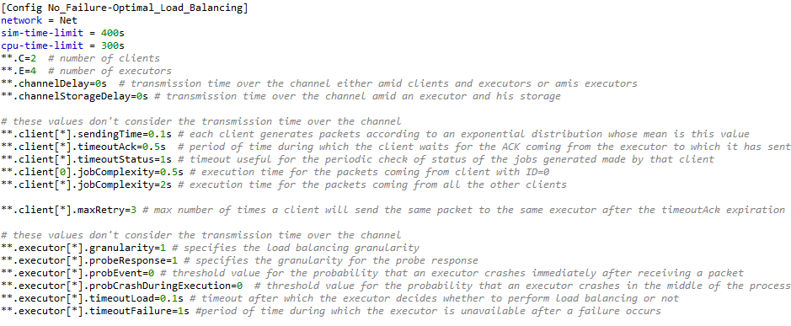
An example(1)-Simulation Parameters

Slide 13
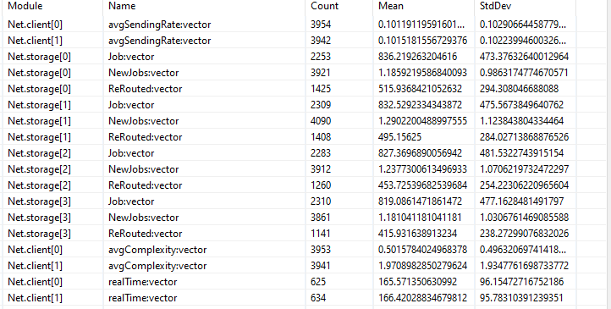
An example(2)-Signals

Slide 14
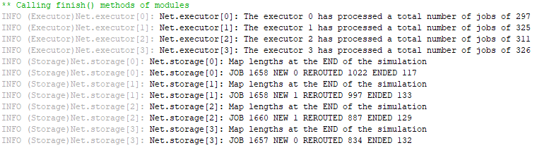
An example(3)-End of simulation values

Slide 15
Questions?
Contacts:
Carloni Filippo 921124
filippo.carloni@mail.polimi.it
Carminati Fabio 919803
fabio3.carminati@mail.polimi.it

